Slide 1
Network programming
Department of informatics
Institut teknologi sepuluh nopember

Slide 2
Outline ftp
FTP
FTP Comm
Reply Code
FTP Command
FTP on Python

Slide 3
FTP
File Transfer Protocol (FTP)
RFC 959
http://www.faqs.org/rfcs/rfc959.html

Slide 4
FTP Communication model
Two TCP connections
One channel for control
Command
Status code
One channel for data

Slide 5
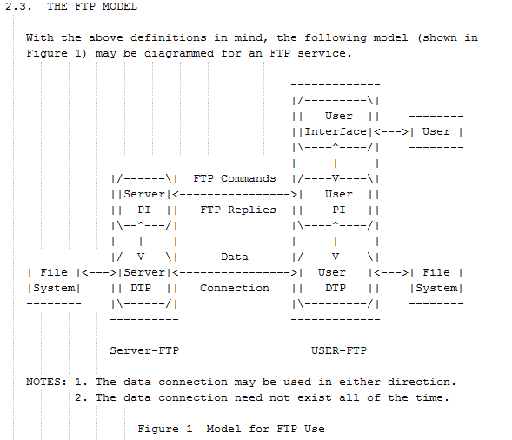
FTP Communication model

Slide 6
Mode aktif dan pasif
Mode ini menentukan bagaimana koneksi untuk transfer data disiapkan dan dikelola
Sangat penting dalam mengatasi berbagai konfigurasi jaringan,
khususnya ketika melibatkan firewall dan perangkat NAT (Network Address Translation).

Slide 7
Active mode
The FTP client opens a command connection from its random unprivileged port to the FTP server's command port (port 21). For the data connection, the client starts listening on a random port and sends the FTP command PORT followed by its IP address and the port number it is listening on.
Upon receiving the PORT command, the FTP server initiates a data connection from its local data port (port 20) to the client’s specified IP address and port number.
Active mode can cause issues when the client is behind a firewall or NAT that does not allow incoming connections to the random ports used by the client. This setup requires the firewall to be specifically configured to allow inbound connections to the range of ports the client might use for the data connection.

Slide 8
PASSIVE MODE
The client still starts by opening a command connection to the server's command port. However, it then sends the PASV command, indicating that it wants to enter passive mode.
In response to the PASV command, the server opens a random unprivileged port and sends back this port number and its IP address to the client. The server then starts listening on this port.
The client then initiates the data connection from a random local port to the server’s provided IP address and port number.
Passive mode is generally more firewall- and NAT-friendly. Since the client always initiates the connections (both command and data), it typically works well when the client is behind firewalls or routers using NAT, as most firewalls and NAT configurations allow outgoing connections.

Slide 9
Example: Download
Create a connection
Authentication (username & password)
Client tells its port to server
Look for directory where a file is located
Server connects to client
Transmit the file
Close the data connection

Slide 10
Example of Communication on FTP
FTP applications:
FTP server: Filezilla Server
FTP client: Filezilla Client
What we do:
Connect
Login
List directory

Slide 11
Home Directory Filezilla Server
Run Filezilla Server: Run as Administrator
Select Edit menu
Select User
Select Shared Folder
Select a folder that can be accessed by users (home directory)
Don’t forget to create a user first (to access the server)

Slide 12
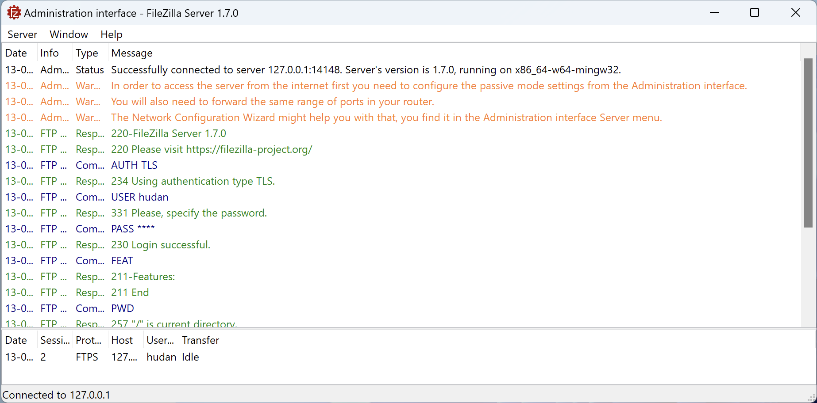
Filezilla Server Ready

Slide 13
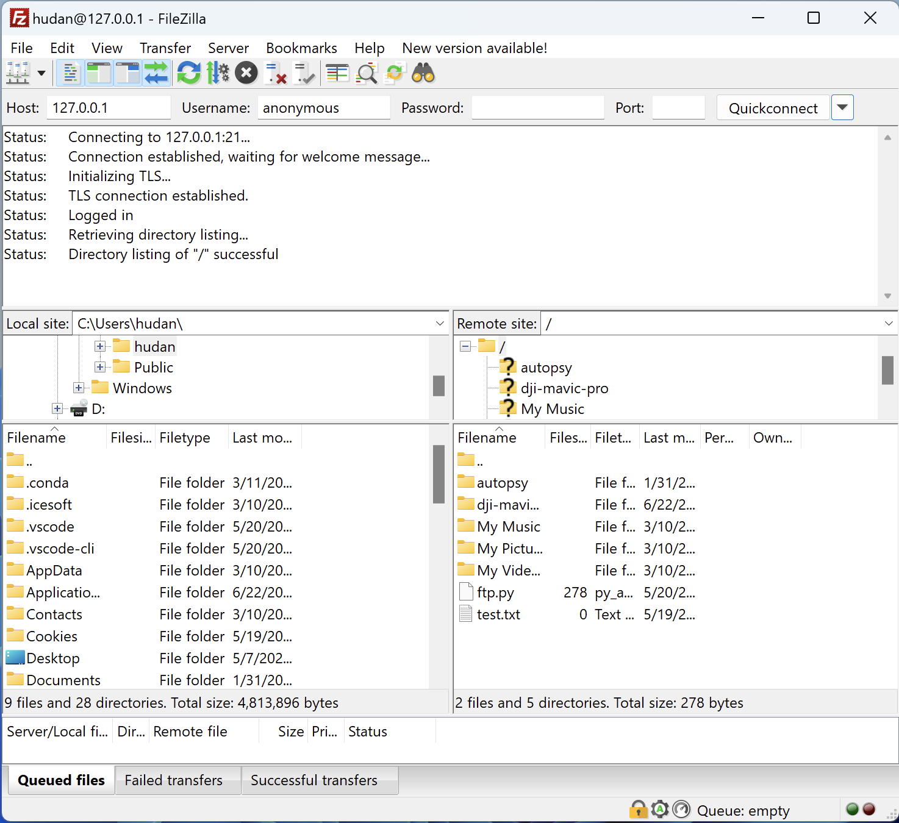
Filezilla Client connects to server

Slide 14
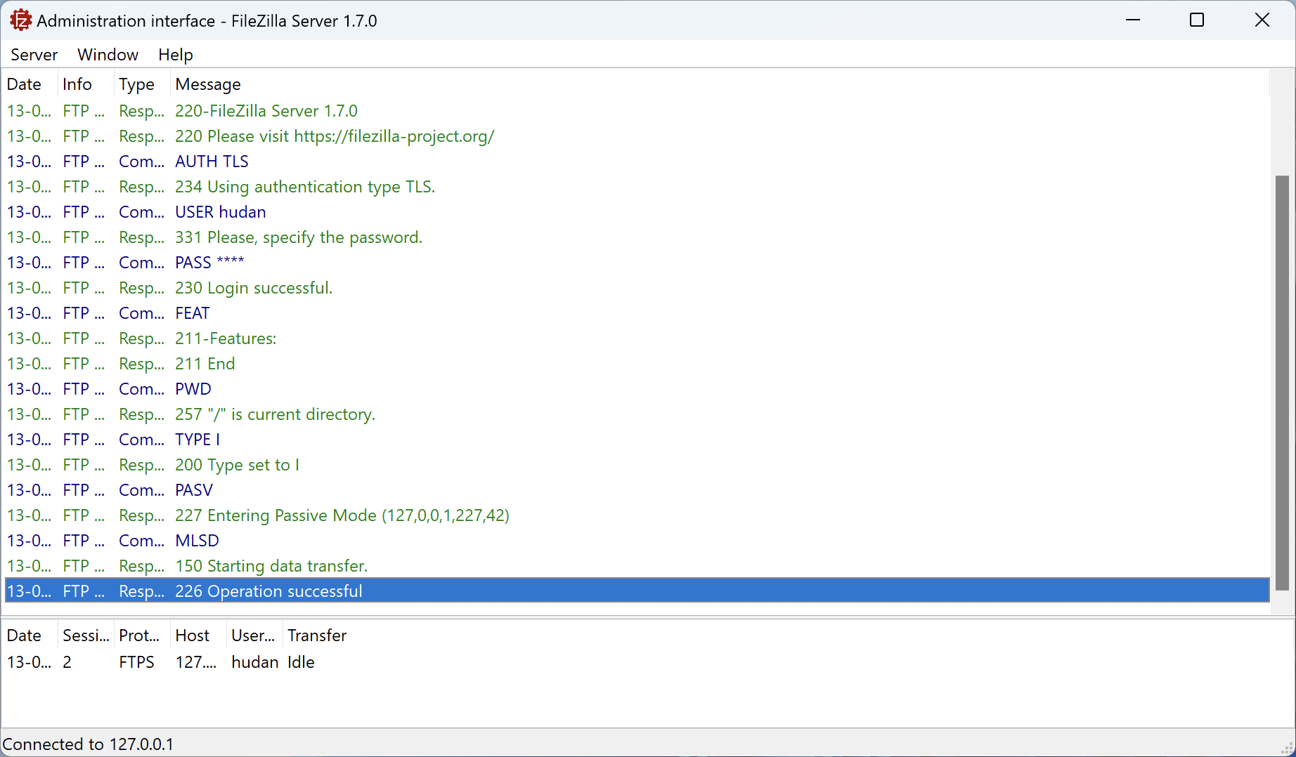
Log records on Filezilla Server

Slide 15
Reply Codes (1)
Based on RFC 959
220 Service ready for new user.
331 User name okay, need password.
230 User logged in, proceed.
215 NAME system type.
211 System status, or system help reply.
257 "PATHNAME" created.

Slide 16
Reply Codes (2)
200 Command okay.
150 File status okay; about to open data connection.
226 Closing data connection.
Requested file action successful.
421 Service not available, closing control connection.

Slide 17
FTP Command
USER: Username
PASS: Password
SYST: System
FEAT: Feature → HELP
PWD: Print Working Directory
MLSD (non-rfc) → LIST

Slide 18
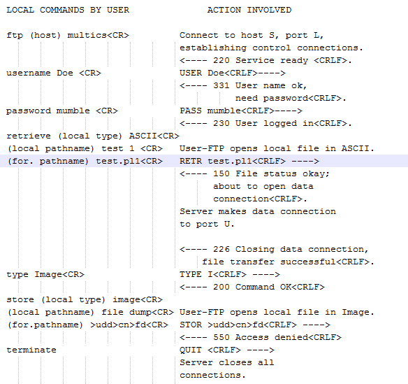
Typical Operation

Slide 19
FTP on Python
The usual socket
FTP client (native) Library
ftplib
FTP server Library
pyftpdlib
https://github.com/giampaolo/pyftpdlib

Slide 20
Example of ftplib: pwd dan list
from ftplib import FTP
f = FTP('localhost’)
print("Welcome:", f.getwelcome())
f.login('hudan’)
print("Current working directory:", f.pwd())
names = f.nlst()
print('List of directory: ', names)
f.quit()

Slide 21
Example of ftplib: download
from ftplib import FTP
f = FTP('localhost')
f.login('hudan')
fd = open('2003.pdf', 'wb')
f.retrbinary('RETR 2003.pdf', fd.write)
fd.close()
f.quit()

Slide 22
code examples
https://github.com/studiawan/network-programming/tree/master/bab06

Slide 23
Outline udp
Port on client-server
Basic of socket UDP programming
Implementation on Python
Example of UDP Socket
Server
Client
Analysis using Wireshark

Slide 24
Port on client and Server
Port on server
Client
Server
Port on klien

Slide 25
Socket type on Python
UDP → SOCK_DGRAM
TCP → SOCK_STREAM

Slide 26
When to use UDP Socket?
A client that if packet loss occurs is not a problem or on an unreliable network
One-way and short request-responses, not a series of back-and-forth request-responses
Build applications on top of UDP
Packet drop and ordering are handled in the application

Slide 27
UDP Socket Server
Create a socket
Bind on ip address and port number
Receive message from client
Send message to client

Slide 28
UDP Server ON Python
socket(socket.AF_INET, socket.SOCK_DGRAM)
bind((server_address, port))
data, address = recvfrom(buffer_size)
sendto(data, address)
Unlike TCP,
do not use
listen() and accept()

Slide 29
UDP Socket Client
Create a socket
Send message to the server
Receive message from the server

Slide 30
UDP client ON Python
Option 1:
socket(AF_INET, SOCK_DGRAM)
sendto(data, address)
recvfrom(buffer_size)
Without using connect(),
must specify the address when send()
Option 2:
socket(AF_INET, SOCK_DGRAM)
connect((server_address, port))
send(data)
recv(buffer_size)
Using connect(),
directly can send() and recv()
without having to enter an address

Slide 31
UDP Server
s = socket.socket(socket.AF_INET, socket.SOCK_DGRAM)
s.bind(('127.0.0.1', 5000))
while True:
data, address = s.recvfrom(MAX)
print(data, address)
s.sendto(data, address)
s.close()
Not using listen() and accept()

Slide 32
UDP client 1
s = socket.socket(socket.AF_INET, socket.SOCK_DGRAM)
s.sendto("Hello", ('127.0.0.1', 5000))
data, address = s.recvfrom(MAX)
s.close()
print(data, address)
Not using connect(),
using sendto() and recvfrom()

Slide 33
UDP client 2
s = socket.socket(socket.AF_INET, socket.SOCK_DGRAM)
s.connect(('127.0.0.1', 5000))
s.send("Hello from connect")
data = s.recv(MAX)
print(data)
Using connect(),
using send() and recv()

Slide 34
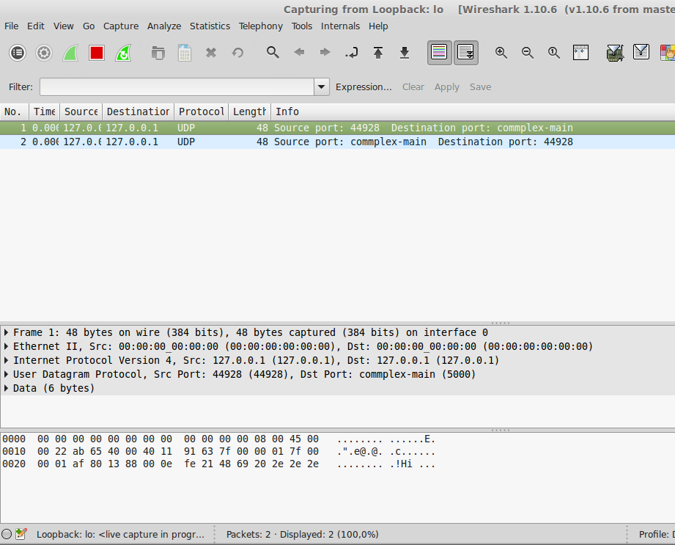
Wireshark analysis: server-udp.py and client-udp1.py

Slide 35

Wireshark analysis: server-udp.py and client-udp2.py

Slide 36
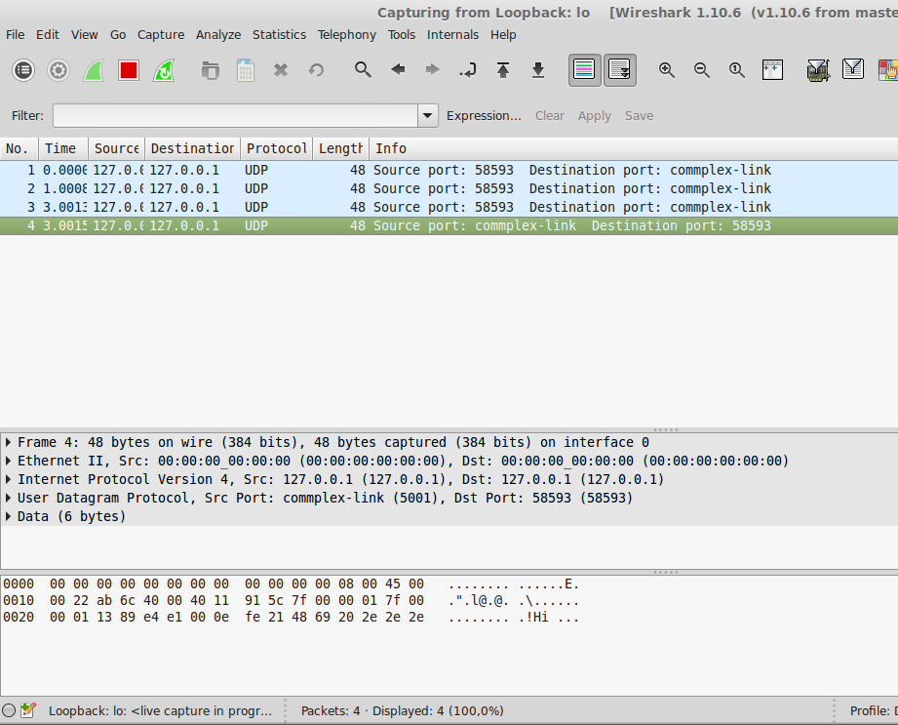
Wireshark analysis: server-udp2.py and client-udp3.py

Slide 37
Code examples
https://github.com/studiawan/network-programming/tree/master/bab07

